Slide 1
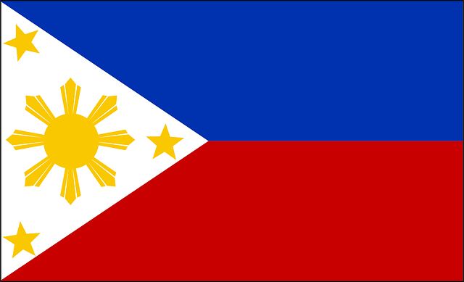
Philippines (Pilipinas)
The Republic Of the Philippines

Slide 2
Overview
-The Capital of the Philippines is Manila and they have 80 provinces and 39 cities.
- Language: Filipino
- Religion: 82.9% Catholic
- Literacy Rate: 92.6%
- Population: 103,775,002
- Life Expectancy: 71.94 years
- Symbol: Eagle

Slide 3
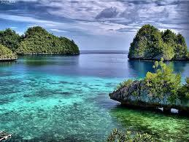
History
The Philippines is thought to have in habitants over 40,000 years ago. It was colonized by the Spaniards in 1521. In May of 1898, the Americans brought liberty from Spanish rule. For only 20 million$ the Americans purchased the Philippines. The Japanese occupied the Philippines from 1942-1944. Finally in 1946, on America's recognized independence day (July 4th), the Filipino people had gained their complete independence.

Slide 4
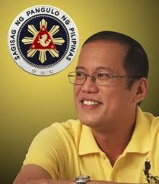
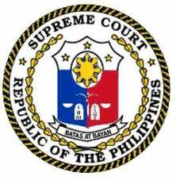
Government
The president of the Philippines is
Benigno Aquino. Presidents serve a
6 year term and are elected by a popular vote.In their legislature there is a house of representatives that is limited to 250 members, and there is also a senate that has 24 seats. Both of these are three year terms per member.

Slide 5
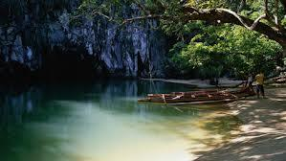
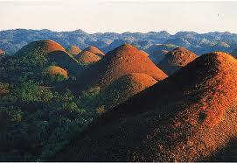
Places to see...
Chocolate Hills Palawan Underground River
The Philippines has many natural beauties such as the chocolate hills, considered the 8th wonder of the world!

Slide 6
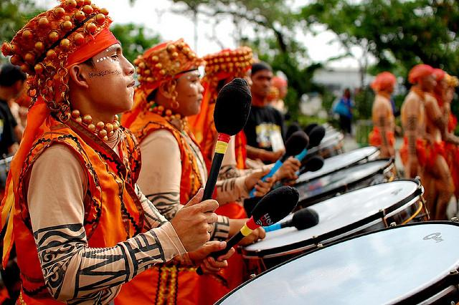
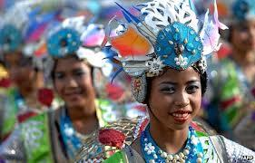
Come Visit us in the Philippines!

